Slide 1


Design and Analysis of Data Structures and Algorithms
Presentation by
Lyernisha S R

Slide 2
Algorithm and problem solving

Slide 3
Algorithm
The term “algorithm” was derived from the name of Mohammed al-Khowarizmi, a Persian mathematician in the ninth century
Al-Khowarizmi → Algorismus (in Latin) → Algorithm.

Slide 4
Algorithm -Definition
well-defined computational procedure consisting of a set of instructions, that takes some value or set of values, as input, and produces some value or set of values, as output.
procedure that accepts data, manipulates them following the prescribed steps, to solve some problem

Slide 5

Algorithm –Definition (Contd..)
An algorithm is simply a procedure or routine.
Different professions have their own form of procedure in their line of work, and they call it different names.
A procedure for a Chef – a recipe that converts the ingredients (input) into some culinary dish (output), after a certain number of steps.

Slide 6
Characteristics of an Algorithm
Each step of an algorithm must be exact, precisely and unambiguously described
An algorithm must terminate
An algorithm must be effective
An algorithm must be capable of generalization

Slide 7
Fundamentals of algorithmic problem solving
Understanding the problem
Choose algorithm design techniques
Designing algorithms and data structures
Methods of specifying an algorithm
Correctness
Analyzing algorithms
Coding an algorithm
Documentation

Slide 8
How do we start to create an algorithm?
Pseudo-Code
A mixture of English statements, some mathematical notations, and selected keywords from a programming language.
There is no standard convention
Each author may have his own style, as long as clarity is ensured.

Slide 9
Algorithm - English
The problem concerned is to find the minimum, maximum, and average of a list of numbers.
First, you initialize sum, count to zero
Then, you enter the numbers, one by one.
For each number that you have entered, assign it to num and add it to the sum.
At the same time, you compare num with min, if num is smaller than min, let min be num instead.
Similarly, you compare num with max, if num is larger than max, let max be num instead.
After all the numbers have been entered, you divide sum by the numbers of items entered, and let average be this result.
End of algorithm.

Slide 10
Algorithm - Pseudocode
sum =count = 0 { sum = sum of numbers;
count = how many numbers are entered? }
min= ? { min to hold the smallest value eventually }
max=? { max to hold the largest value eventually }
for each num entered
Increment count
sum =sum + num
If num<min then min = num
If num>max then max = num
ave= sum/count

Slide 11
Important problem types
Sorting
Re-arranging the elements of a list into a desired order(numbers or characters or records)
Why sort? To make search more efficient
Searching
Finding a given value in a list or collection of elements
Range from simple sequential search to binary search
Lists are often sorted prior to being searched
String processing
A string is a sequence of letters from the alphabet

Slide 12
Important problem types (Contd..)
Graph problems
Graphs are used to model a wide variety of problems
We thus need efficient algorithms to process them
Eg. shortest-path algorithms and topological sort
Combinatorial problems
Analyzing a combinatorial object such as a permutation to extract a collection or object that satisfies some goal
Geometric problems
In solving a geometry problem, the data can be the length of a rectangle, the area of a circle, etc.
Numerical problems
Algorithms for solving complex math problems

Slide 13
Data Types and Data Structures
In algorithmic problem solving, we deal with objects.
Objects are data manipulated by the algorithm.
To a cook, the objects are the various types of vegetables, meat and sauce.
In algorithms, the data are numbers, words, lists, files, and so on.
Algorithm provides logic or behaviour
Data provide values or state

Slide 14
Data structures
Types of data used
How the data are organized?
Data come in different forms and types.
Simple data types - integers, real numbers and characters
Complex data structures - arrays, objects, sets, records and files
Algorithms manipulate data, data is stored in variable names
Eg: In mathematics, we call the area of a circle A, and express A in terms of the radius r. (In programming, we use variable names such as area and radius instead of A and r for the sake of readability.)

Slide 15
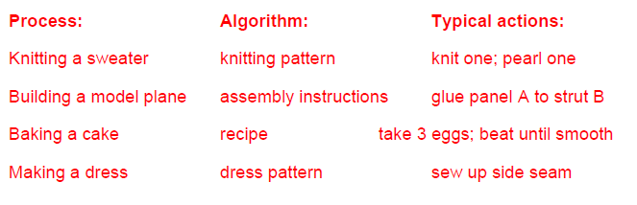
Algorithm design, analysis and problem solving
The importance of algorithms:
Algorithms are central to programming
Algorithms are independent of technology, programming language
A language merely expresses the algorithm, the computer merely executes it.
There are guidelines for algorithm design, but no hard-fast rules – there are no algorithms for algorithm design!

Slide 16
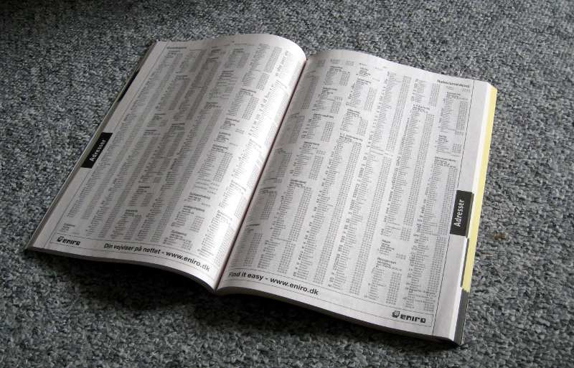
Problem-solving processes
Problem-solving is complex and challenging, to a great extent, systematization.
We encounter and solve problems daily on a continuous basis
But we do not always reflect on how we solve problems – the process is often not transparent to us.
E.g.: telephone directory.

Slide 17
Problem-solving processes (Contd..)
Problem definition
Starting the problem solution
Using past experience
General problem-solving strategies

Slide 18



Design of algorithms
Process ,Input and output:
Process | Input | Output
Knitting a sweater | wool | sweater
Building a model plane | wood | plane
Baking a cake | flour | cake
Making a jacket | fabric | jacket

Slide 19
Process
Process specification should be precise
Algorithm design is highly complex except for the most trivial cases
Humans can cope with uncertainty and vagueness
Algorithmic process specification has to consider everything
The algorithm has to work 100% correctly EVERY time

Slide 20
Stepwise refinement
One approach is called:
Step-wise refinement or functional decomposition or top-down design or divide and conquer
It is a way to manage complexity
Problems are broken down into manageable chunks
Enables developer to obtain a global view of the process from the start

Slide 21
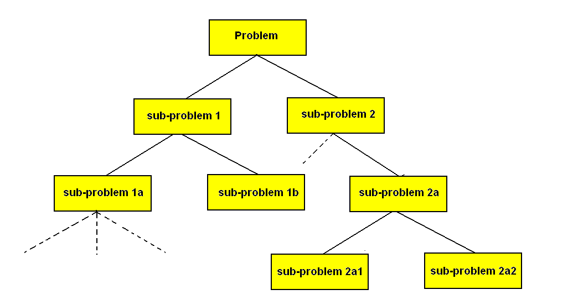
Stepwise refinement

Slide 22
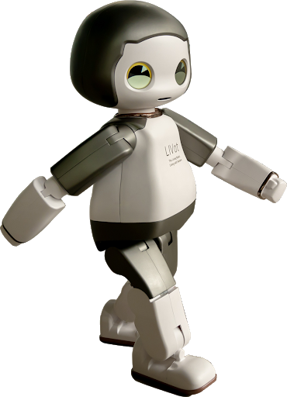
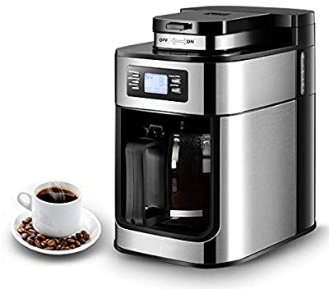
Algorithms and problem-solving
Design a robot domestic servant that can make a cup of instant coffee
Specify this process in not more than 4 high-level steps

Slide 23
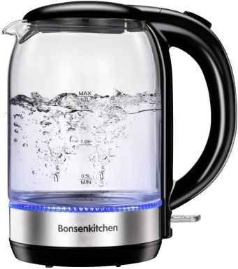
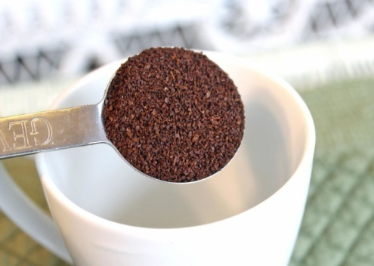
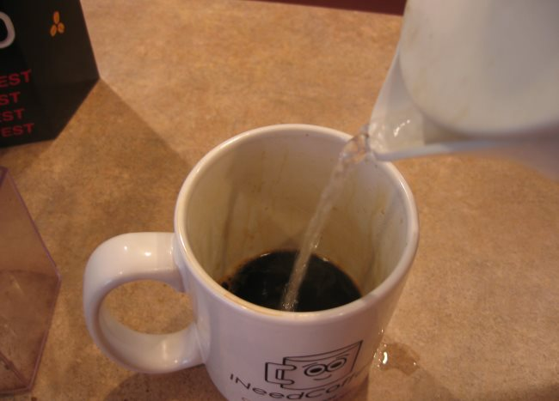
Example
High level specification/algorithm:
Boil water
Put coffee and sugar in cup
Add water to cup

Slide 24
Example (Contd..)
Refine high-level step 1 into not more than 4 sub-processes
1.Step BOIL WATER can be further refined into:
1.1 Fill kettle
1.2 Switch on kettle
1.3 Wait until boiling
1.4 Switch off kettle
2.Step PUT COFFEE IN CUP can be further refined into:
2.1 Open coffee jar
2.2 Extract one spoonful of coffee
and sugar
2.3 Tip spoonful into cup
2.4 Close coffee jar

Slide 25


Example (Contd..)
3.Step ADD WATER TO CUP can be further refined into:
3.1 Pour water into cup
3.2 Stop when it is full
But these steps may also be insufficiently specified.
4.Step FILL KETTLE can be further refined into:
4.1 Put kettle under tap
4.2 Turn on tap
4.3 Wait until kettle is full
4.4 Turn off tap
This process of decomposition and refinement can continue until the level of specification is complete to enable the algorithm (or robot) to complete a fully process.

Slide 26
Thank you!

